Slide 1

NETFLIX CONTENT ANALYTICS
Excel Dashboard & Data Analysis Project
From raw content data to interactive insights
Data Cleaning • Calculated Columns • PivotTables • KPIs • Charts • Slicers
Prepared by
Dorothy Das
Netflix Content Analytics | Excel Dashboard 1

Slide 2
Agenda
Objective
Dataset Overview
Data Cleaning
Calculated Columns
Chart Specification
Dashboard Layout
Key Insight and Recommendation
Presentation Title

Slide 3





Objectives
Build an interactive Excel dashboard for content-level analysis.
Transform raw fields into meaningful analytical dimensions.
Measure content performance using IMDb and TMDB metrics.
Identify patterns by genre, content type and release period.
Present insights through KPIs, PivotTables, charts and slicers.

Slide 4
Dataset Overview
Column | Data Type | Description
Genre | Text | Genres associated with the title
Title | Text | Name of the movie or TV show
Type | Text | Indicating whether it is a Movie or a TV Show.
Release_Year | Date | Actual release year
Runtime | Whole Number | Runtime in minutes
Description | Text | Overview of the title
IMDb Rating | Decimal | IMDb rating score
IMDb Votes | Whole Number | Number of IMDb votes
TMDb Rating | Decimal | TMDb rating score
TMDb Popularity | Whole Number | TMDb popularity metric
Total Rows
24599
Movies/Shows
52% / 48%
Unique Titles
6957
Missing Values
1821

Slide 5
Data Cleaning
Promote Headers & Set Types
Handle Missing Values
1
5
First row->headers; genre, title, type, release year, runtime, etc.
Replaced all the empty columns having numeric data type with 0.
Format Change
Trim Text
2
6
Changed the format of the released year by creating a new column. Ex: 1945 to 1940s
Applied to genre, title, type, description.
Standardize Case
Close & Load to Model
3
7
Format->Capitalize each word on columns having Text datatype.
Loaded the clean table into excel.
4
Checking Duplicate Rows
No duplicate columns, titles contain unique values.

Slide 6
Calculated Columns
Columns | Purpose | Formula
Content_Age | How old the title is? | =2026-[@release_year]
Release_Decade | Groups titles by decade | =INT([@release_year]/10)*10&"s"
Runtime_Category | Groups content by duration | =IF([@runtime]<60,"Short",IF([@runtime]<=120,"Medium","Long"))
Rating_Category | Groups IMDb ratings | =IF([@imdb_rating]<5,"Poor",IF([@imdb_rating]<7,"Average",IF([@imdb_rating]<8,"Good","Excellent")))
Vote_Category | Groups titles by IMDb votes | =IF([@imdb_votes]<10000,"Low Votes",IF([@imdb_votes]<=100000,"Medium Votes","High Votes"))
Tmdb_Rating_Category | Groups TMDB ratings | =IF(I2="","",IF(I2>=8,"Excellent",IF(I2>=7,"Good",IF(I2>=6,"Average","Low"))))
Popularity_Category | Groups TMDB popularity | =IF(J2="","",IF(J2>=100,"Very High",IF(J2>=50,"High",IF(J2>=20,"Medium","Low"))))
Rating_Gap | Difference between IMDb and TMDB ratings | =[@imdb_rating]-[@tmdb_rating]

Slide 7
Chart Specifications
KPIs
Total Title, Total Movies, Total Series, Average Runtime.
Average Imdb Rating, Average Tmdb Rating, Maximum Tmdb Rating, Average Runtime.
Total Imdb Votes, Average Imdb Votes, Total Tmdb Popularity, Maximum Tmdb Popularity.
Latest Release Year, Earliest Release Year, Average Runtime, Latest Runtime.
Content Overview
Rating and Quality
Audience and Popularity
Release and Runtime
Line Chart-Title by Release Decade.
Donut Chart- Tile by Type.
Column Chart- Title by Genre.
Bar Chart- IMDB by TMDB Rating.
Donut Chart- Rating Category Description.
Column Chart- IMDB Rating by Genre.
Line Chart- Popularity by Genre.
Bar Chart- IMDB votes by Genre.
Column Chart- Popularity Category.
Line Chart-Title by Release Year.
Donut Chart- Runtime Category.
Column Chart- Average Runtime by Type.

Slide 8
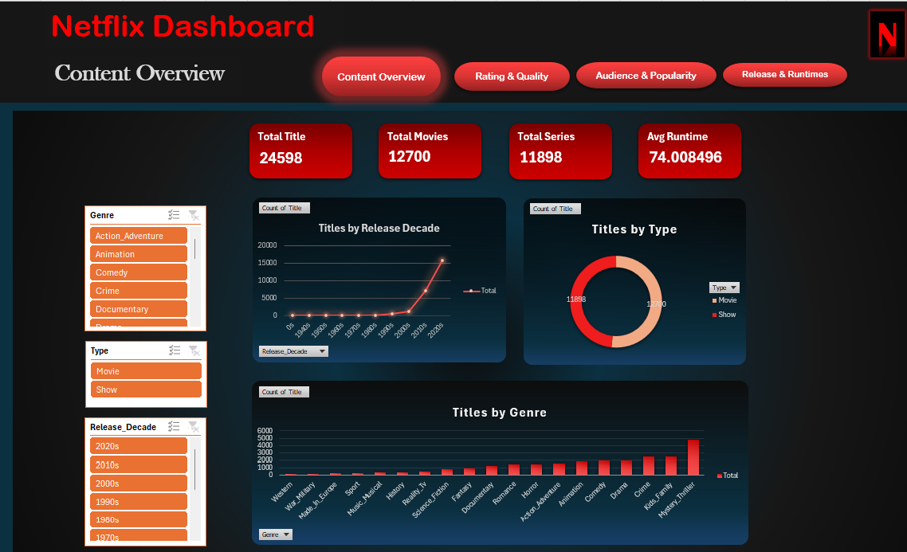

Slide 9
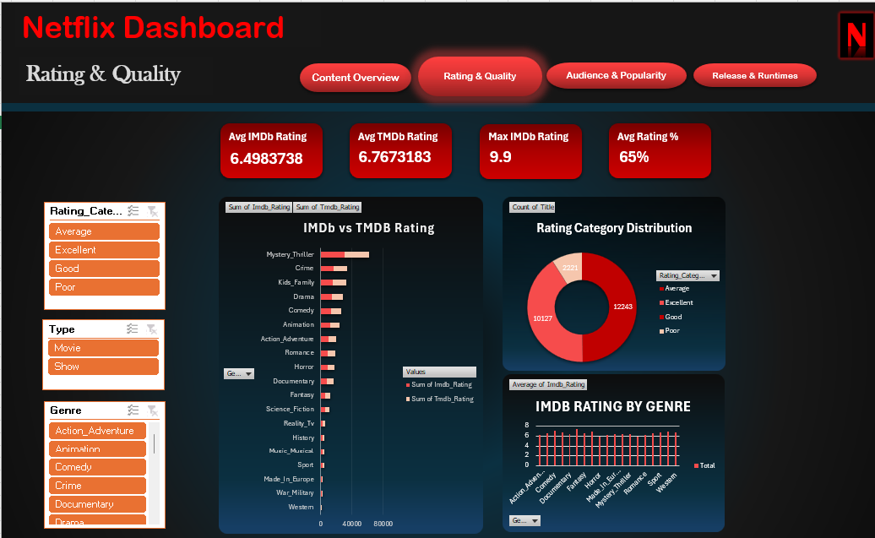

Slide 10
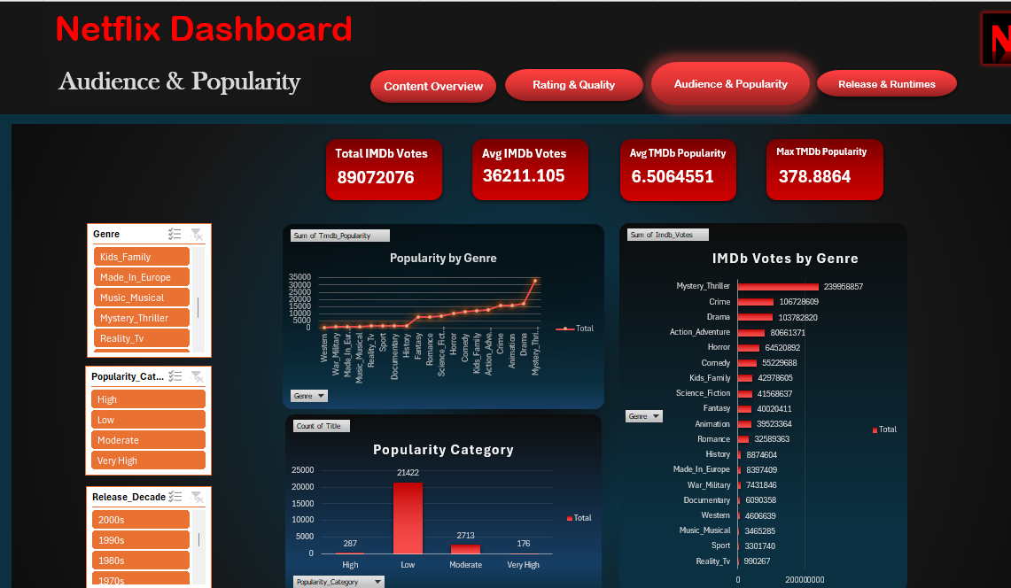

Slide 11
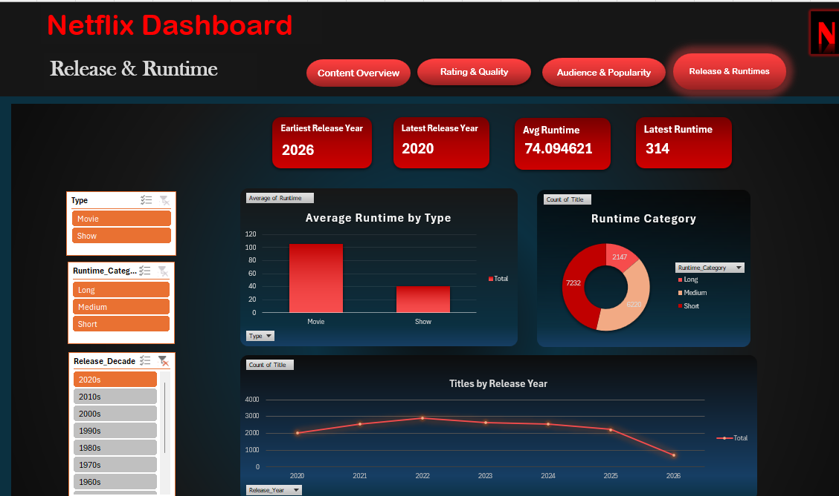

Slide 12
Key Insights & Recommendation
Key Insights
Recommendation
1
High ratings do not always mean high popularity.
Increase visibility of highly rated but less-popular titles through personalized recommendations, featured sections, or targeted promotion.
Some titles may receive strong IMDb/TMDB ratings but comparatively lower popularity.
2
Higher IMDb votes generally indicate greater audience attention.
Use ratings together with vote volume when identifying content with strong audience engagement rather than relying on ratings alone.
Vote count can help identify titles that attract significant viewer interest.
3
Content Varity
Maintain content diversity while focusing investment on genres and content types that demonstrate stronger audience engagement.
Netflix has a diverse mix of movies and TV shows across multiple genres.
12

Slide 13
Summary
Data Preparation: Cleaned and organized the dataset, handled data types, and prepared the data for analysis.
Calculated Columns: Created useful analytical fields such as Release Decade, Content Age, Runtime Category, Rating Category, TMDB Rating Category, Popularity Category, and Rating Percentage.
Content Analysis: Analyzed movies and TV shows across genres, release years, and runtime categories.
Rating & Popularity Analysis: Compared IMDb and TMDB ratings with audience engagement and popularity indicators.
Dashboard Development: Created KPIs, PivotTables, charts, and slicers to make the analysis interactive and easy to understand.
Business Value: The dashboard provides a clear view of Netflix's content distribution, quality, popularity, and release trends, helping identify patterns and areas of audience interest.

Slide 14
Conclusion
Overall, this project demonstrated how Excel can be used to transform raw Netflix content data into an interactive and meaningful analytical dashboard. The analysis provided insights into content distribution, ratings, audience engagement, popularity, and runtime patterns. Through this project, I gained practical experience in the complete data analytics workflow—from data cleaning and transformation to visualization and insight generation.

Slide 15




Thank you

